Slide 1


WASM + Rust

Slide 2


What’s WASM
Portable binary code
Supported by all major browsers
Wasmer + Docker for desktop support
"If WASM+WASI existed in 2008, we wouldn't have needed to create Docker.”
- Solomon Hykes

Slide 3
What’s WASI
Interface (ABI) designed by Mozilla
POSIX-like features like:
File System
Networking
Time
Random
Pretty important for running outside a browser

Slide 4
How does rust fit?
Allows us to run sandboxed applications from rust
Allows us to run rust applications in places we wouldn’t usually be able to
Allows us another approach for cross-platform development

Slide 5
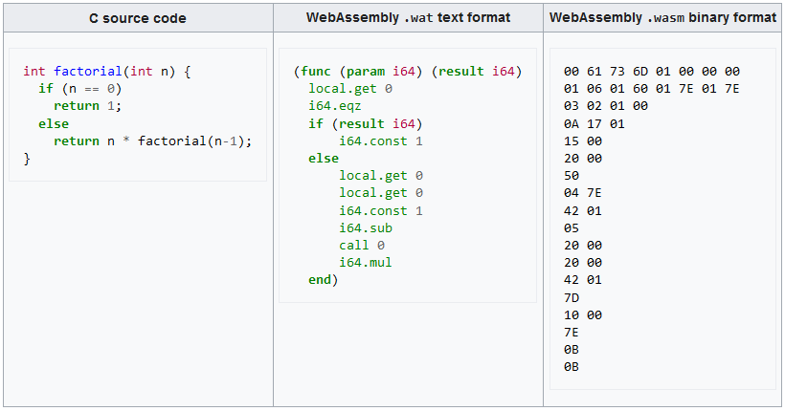
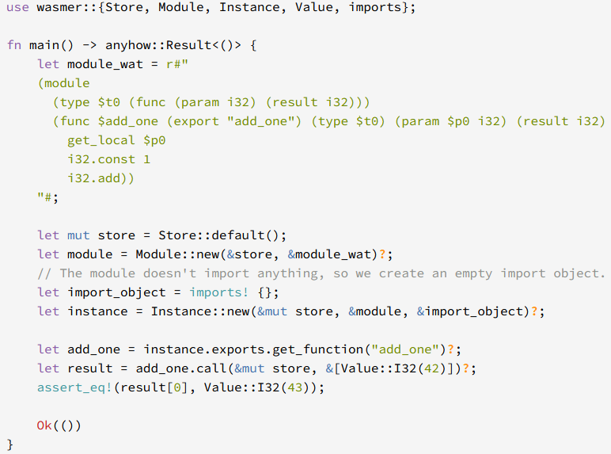
How does rust fit?
Allows us to run sandboxed applications from rust
Allows us to run rust applications in places we wouldn’t usually be able to
Allows us another approach for cross-platform development

Slide 6
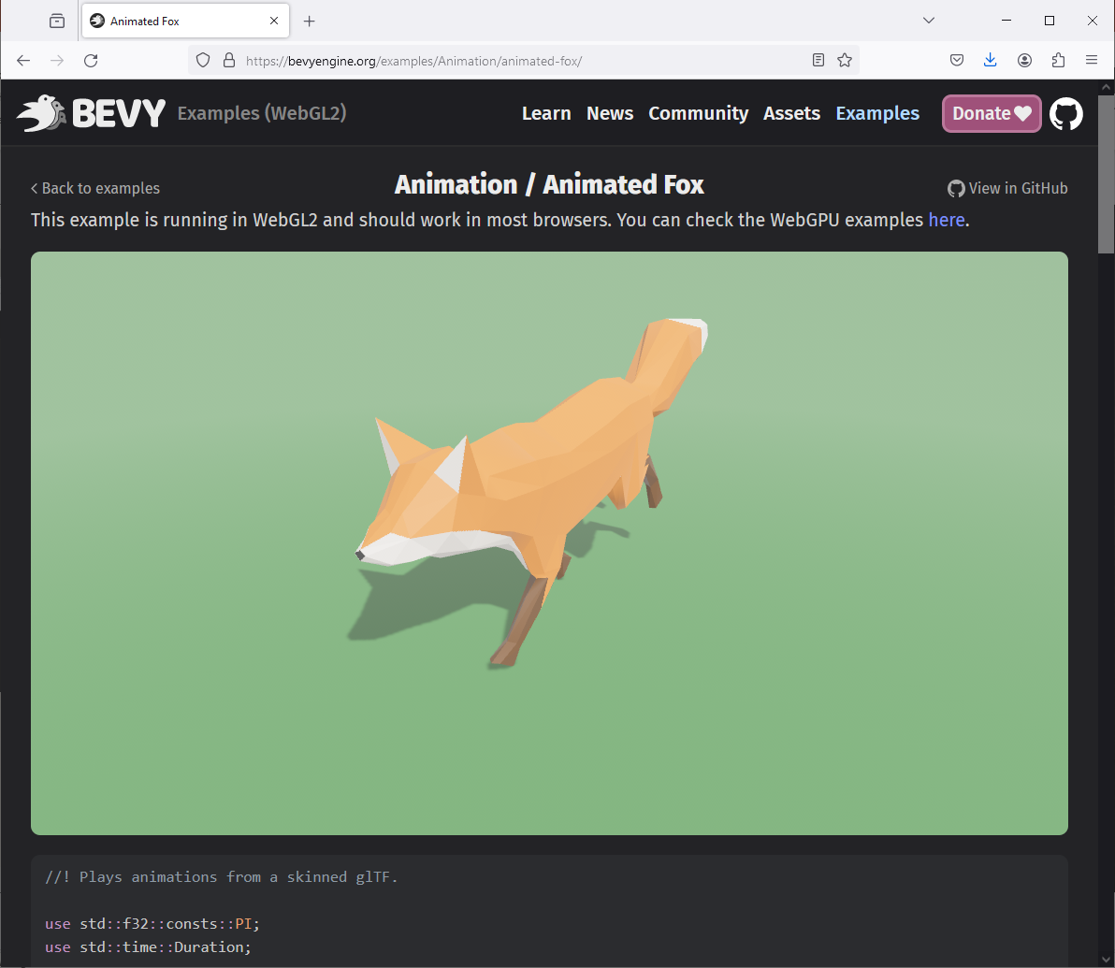
How does rust fit?
Allows us to run sandboxed applications from rust
Allows us to run rust applications in places we wouldn’t usually be able to
Allows us another approach for cross-platform development
https://bevyengine.org/examples/Animation/animated-fox/

Slide 7
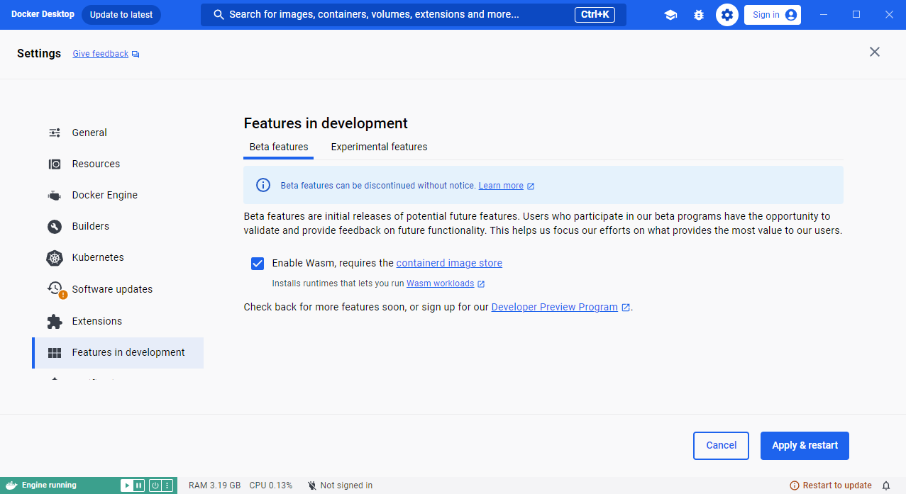
How does rust fit?
Allows us to run sandboxed applications from rust
Allows us to run rust applications in places we wouldn’t usually be able to
Allows us another approach for cross-platform development
docker run \
--runtime=io.containerd.wasmedge.v1 \ --platform=wasi/wasm \
secondstate/rust-example-hello

Slide 8
Let’s get setup
Add wasm support:
rustup target install wasm32-unknown-unknown
Easy wasm projects:
cargo install create-tauri-app --locked
cargo create-tauri-app
npm create cloudflare@latest – project_name
cd project_name
Finding Dependencies:
https://crates.io/keywords/wasm https://lib.rs/wasm

